Slide 1

Capstone Project-2
Seoul Bike Sharing Demand Prediction
Prepared By
Nitin Solanki (solankinitin1210@gmail.com)

Slide 2
Points of discussion
Problem Statement
To know the Dataset
Preparing dataset for analysis
Do EDA on the Dataset
Plot Distribution Chart for All the Variable
Plot Regression Chart for Independent Variable V/s Dependent Variable
Check the Multi-Collinearity
Deal With Categorical Columns
Prepare Data for ML Model
Run Different ML Model
Score Board
Feature Selection
Conclusion

Slide 3
Problem Statement
Rental bikes are introduced in many urban cities for the enhancement of mobility comfort. It is important to make the rental bike available and accessible to the public at the right time as it lessens the waiting time. Eventually, providing the city with a stable supply of rental bikes becomes a major concern.
We have been given a dataset which contains weather information (Temperature, Humidity, Wind speed, Visibility, Dew point, Solar radiation, Snowfall, Rainfall), the number of bikes rented per hour and date information.
From the given information we need to prepare a machine learning model which can predict the bike count required at each hour for the stable supply of rental bikes.
We are looking for
To what extent we can predict the bike count required for the stable supply of rental bikes using machine learning?
Which machine learning algorithm gives the highest prediction accuracy?
Which features are the most important for bike count prediction?

Slide 4
To Know Our Dataset
Initial observations for the given dataset are
The Given dataset contain 8760 rows and 14 columns.
No column was found with null values.
Data contained by every column are in the required datatype except the "Date" column hence data type conversion is only required for the "Date" Column.
Out of 14 columns, the Number 12 Columns contain the numeric data and 3 columns contain categorical data
Our Dependent/Target variable is "Rented Bike Count", rest are Independent variable
The data contained by our target variable is not in a normalized format, we conclude this by checking the mead and median values, the difference between mean and median is a huge number (200+)(We’ll verify this by plotting the chart)
Our target variable contains the numeric data so our approach will be a regression model of machine learning.
Let’s Check all the variable in detail

Slide 5
Variable Description
Sr. | Column | Column Description | Null Values | Data type
1 | Date | Year-Month-Day | 0 | Object
2 | Rented Bike count | Count of bikes rented at each hour | 0 | Integer
3 | Hour | Hour of the day (0-23) | 0 | Integer
4 | Temperature(°C) | Temperature in Celsius for Hour of the day | 0 | Float
5 | Humidity(%) | Humidity in percentage for Hour of the day | 0 | Integer
6 | Wind speed(m/s) | Humidity in m/s for Hour of the day | 0 | Float
7 | Visibility(10m) | Humidity in meters for Hour of the day | 0 | Integer
8 | Dew point temperature(°C) | Dew Temperature in Celsius for Hour of the day | 0 | Float
9 | Solar radiation(MJ/m2) | Humidity in MJ/m2 for Hour of the day | 0 | Float
10 | Rainfall(mm) | Humidity in mm for Hour of the day | 0 | Float
11 | Snowfall(cm) | Humidity in cm for Hour of the day | 0 | Float
12 | Seasons | Winter, Spring, Summer, Autumn | 0 | Object
13 | Holiday | Holiday/No holiday | 0 | Object
14 | Functional Day | No-Func(Non Functional Hours), Fun(Functional hours) | 0 | Object

Slide 6
Preparing the dataset for EDA
Before we start our EDA it is very important to prepare our dataset for EDA which contain 2 things
1. Deal with null values
In our initial analysis we found that there is no columns with null values so no require to handle null or missing data
2. Add required column in the dataset
In our Data set there is “Date” variable and we need to deal with this variable before start our analysis
First we converted our variable datatype from object to Date format and then extracted the week from date
Here we know that month and seasons are correlated for ex. Winter start from month December and ends at month February, So instead of keeping date and month we choose to convert them into week no. and added a week column
We also removed the year columns because given dataset contains the data for year 2017 and 2018 and for year 2017 only one month (December) data is given so, if keep the year column and later some unseen data with other year (for ex 2016) come, at that time our model will not perform well.

Slide 7

Now we know all the important columns are there in our data and all of them are in the required format so we will explore our data by selecting some categorical variable and then we’ll plot a chart for categorical variable v/s Target variable, we’ll do analysis as listed below
Season wise analysis
Holiday/Non-Day wise analysis
Hour wise analysis
Functional day-wise analysis
So Let’s Start our EDA

Slide 8
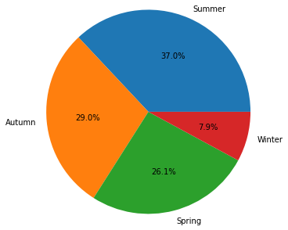
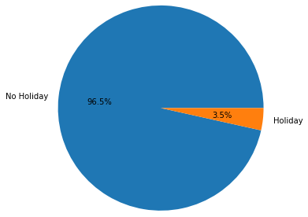
Holiday wise Analysis
Season wise Analysis
The highest number of bikes rented in the summer season and lowest number of bikes rented in the Winter Season
One of the reasons for lower booking in winter could be the temperature, so we assume that temperature plays the major role in rental bike booking (We’ll verify this while plot temp. v/s Rental Bike count)
More than 90% of bikes have been rented on Non-holiday, and only 10% of bikes rented on holidays
From this result, we can assume that most working professionals are using the Seoul bike to rent a bike to travel to the workplace

Slide 9
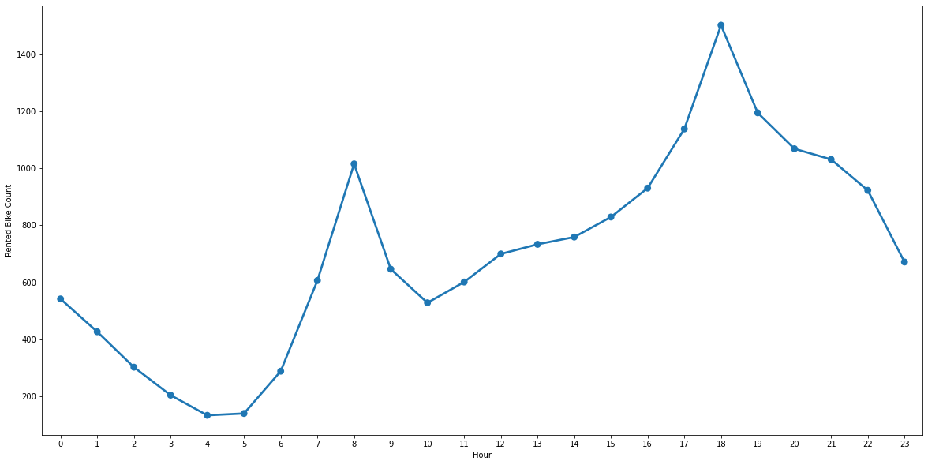
Hours wise booking analysis
Rented bikes numbers stay low during the Night-time (10 PM to 5 AM) and after noon time.
No. of the bike count getting an increase from 6 AM and during the time (6 AM to 8 AM) chart reach at its first pick The same shape of the curve can be shown from (12 pm to 7 PM), At 7 PM highest number of bikes has been rented
Functional day-wise analysis
No Bikes are rented on Non-Functional days so It’s off for the Seoul bike

Slide 10
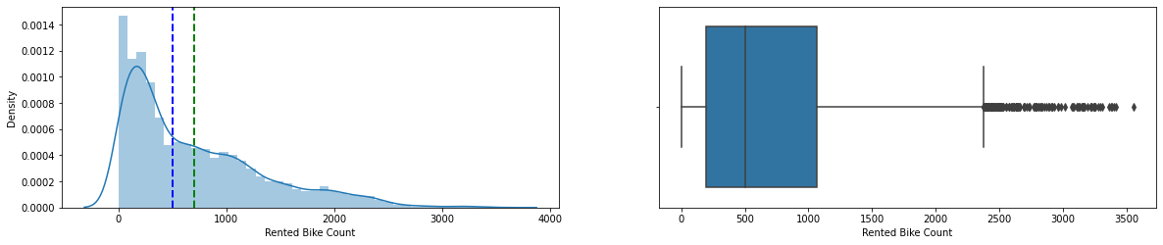
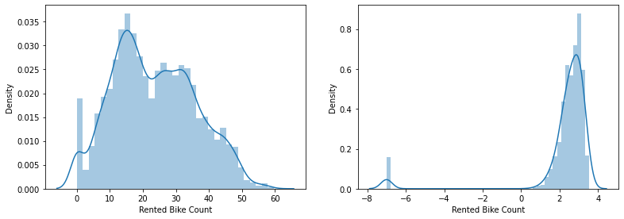
Distribution of Data : Target Variables
We can see that the Distribution chart of our target variable is positively skewed, so before we input this Linear ML model it requires to normalize, So let’s do some experiment to normalize it
Our data in the Squared root transformation plot is normalized to some extent, so we will go with square root on our dependent variable
Squared Root Transformation
Log Transformation

Slide 11
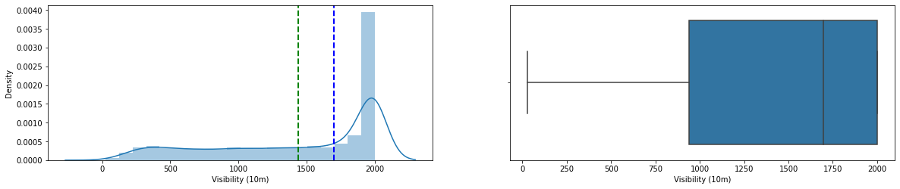
Distribution of Data : Independent Variables
Now we’ll plot all the numerical columns by histogram and box plot chart and check the data distribution for all the those variable
After plotting all the variable we have observed that the distribution chart of Some of our columns are skewed positively and some are skewed negatively and from the box plot we observed that all the variables are contained few or many outliers
We need to treat these columns before feeding them into the linear regression model.
Variable with Negative Skewed Chart
Visibility

Slide 12
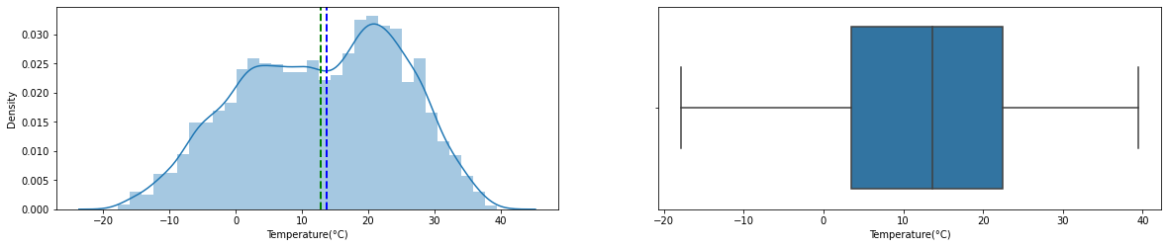
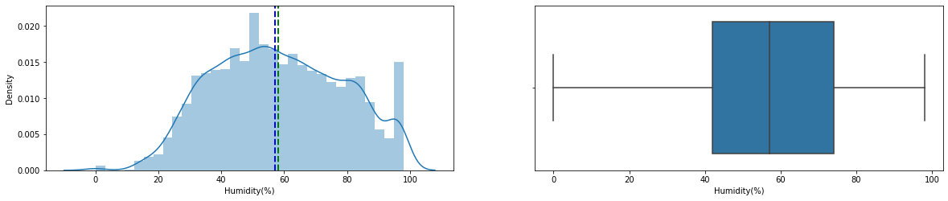
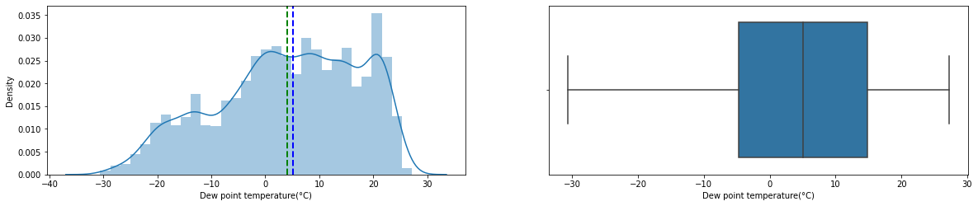
Variable with Normalized Data
Temperature
Humidity
Dew Point Temperature

Slide 13
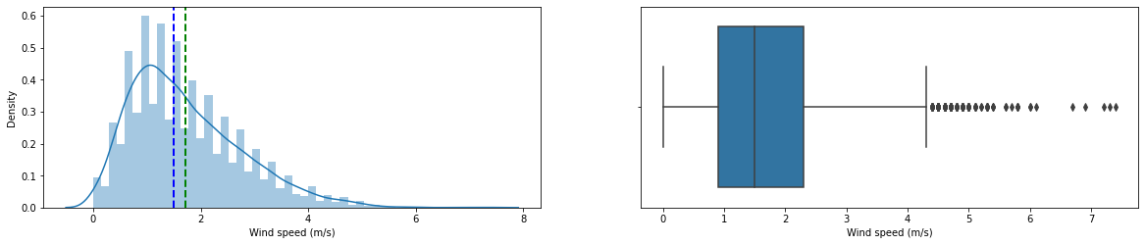
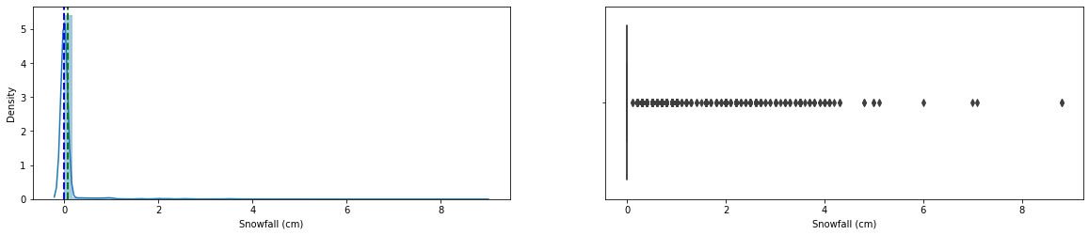
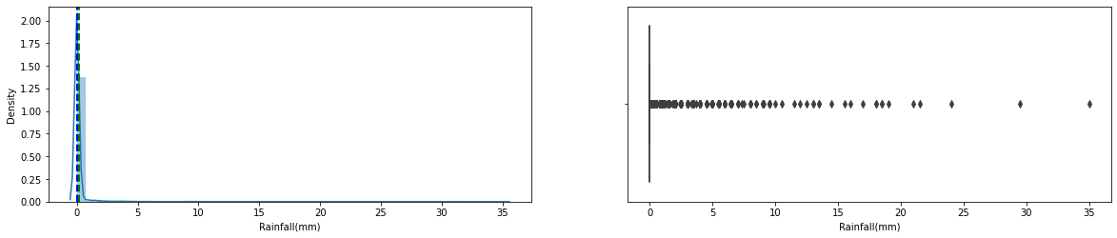
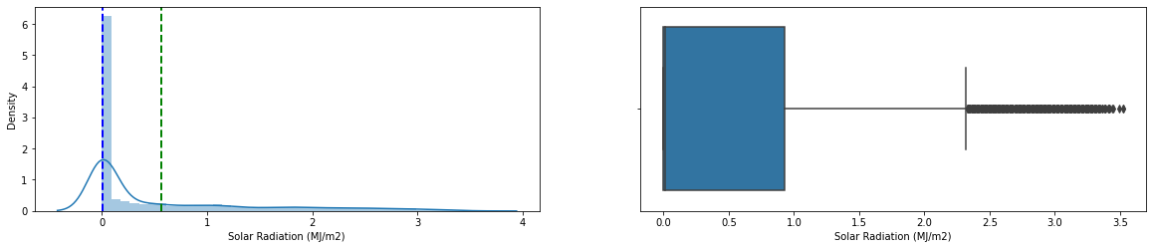
Variable with Positive Skewed Chart
Wind Speed
Snowfall
Rainfall
Solar Radiation

Slide 14
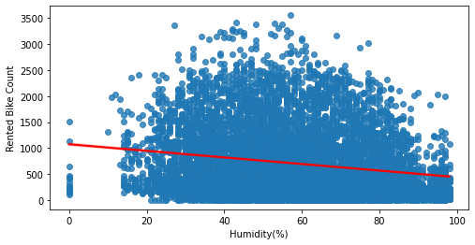
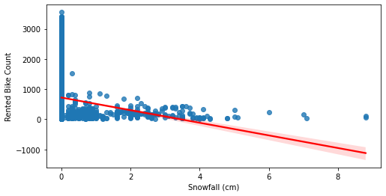
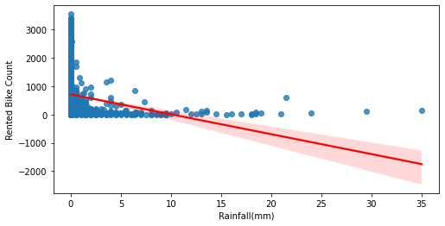
Plot Regression line
To check the relationship of each variable with the target variable we’ll plot the regression line of Variable v/s Target variable
After plotting the regression line it’s been found that the some of the variables are positively and some of them are negatively correlated with the target variable
It’s been concluded from the regression chart that the temperature is the factor which effects highly to the rented bike count positively, as temperature rises rented bike count increases in case of snowfall and rainfall, these variables affect rented bike count in a negative way so the higher bikes were rented when there is no rainfall or snowfall
Negative Collinearity
Humidity
Snowfall
Rainfall

Slide 15
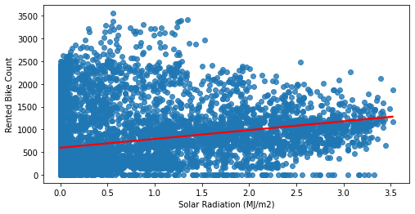
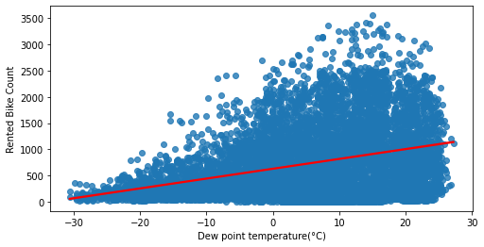
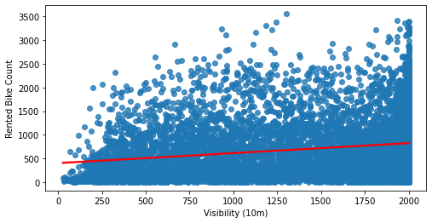
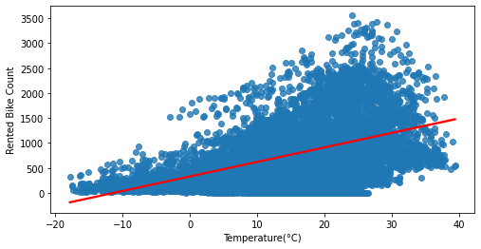
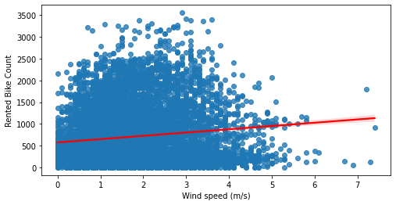
Positive Collinearity
Solar Radiation
Dew Point Temp
Visibility
Temperature
Wind Speed

Slide 16
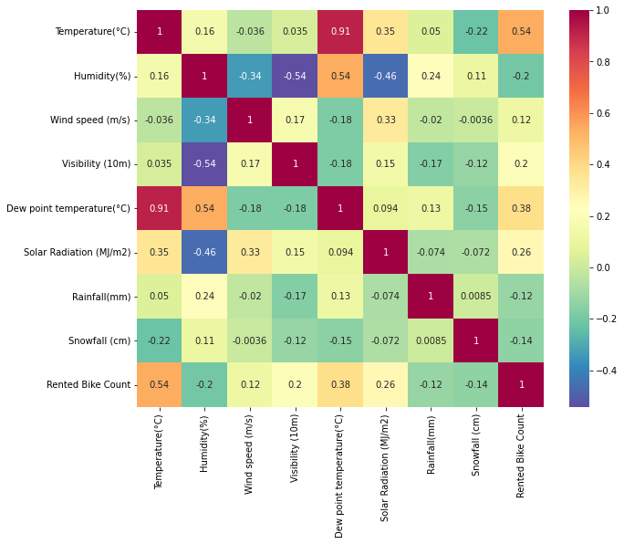
Multicollinearity
To check the multi-collinearity, we have used the heat map and VIF, from both these factor it’s is been found that temperature and dew point temperature is highly correlated, So We choose to remove the dew point temperature from our dataset
After removing the dew point temperature our VIF becomes less than 5 so now we can say that there is multicollinearity and we can proceed further
Before Removing Dew Temp
After Removing Dew Temp
Sr. | Variables | VIF
0 | Temperature(°C) | 29.075866
1 | Humidity(%) | 5.069743
2 | Wind speed (m/s) | 4.517664
3 | Visibility (10m) | 9.051931
4 | Dew point temperature(°C) | 15.201989
5 | Solar Radiation (MJ/m2) | 2.821604
6 | Rainfall(mm) | 1.079919
7 | Snowfall (cm) | 1.118903
Sr. | Variables | VIF
0 | Temperature(°C) | 3.166007
1 | Humidity(%) | 4.758651
2 | Wind speed (m/s) | 4.079926
3 | Visibility (10m) | 4.409448
4 | Solar Radiation (MJ/m2) | 2.246238
5 | Rainfall(mm) | 1.078501
6 | Snowfall (cm) | 1.118901

Slide 17
Deal With Categorical Data
It is crucial to handle categorical data during the pre-processing phase, as in the data having 3 categorical features, namely Seasons, Holidays, and Functioning Days.
Machine learning can seldom deal with categorical data. So need to convert these categorical data to numeric data and to do so we have used 2 following techniques
1. Label Encoding
Columns Holiday and Function will be encoded with use of this technique
All the Non-holiday will be converted into 1 and Holiday will be converted into 0
Same ways all the Function day will be converted into 1 and No-Functional days will be converted into 0
2. On-Hot Coding
Season and Hour columns will be converted using this technique
Separate columns will be created for all four the seasons
Hour Column in our data set is also a categorical columns as it contains 24 Discreet values so, it also need to convert (I’ve tried without converting this column but I got better result after converting this column specially for linear model so I choose to convert it using the One hot coding),So 24 Different columns will be created hours

Slide 18
Preparing the dataset for ML
Now when we have done our EDA, and added the require columns to our dataset, before we feed it to ML model, needs to declare some important points
1. Declare our X and Y
In our data set all the variable except “Rented bike count” will be our X-Independent Variables and “Trented bike count” will be our Y-Dependent variable
2. Training and Testing Data set
To train our models and then after training, to test the performance we have split our dataset in 2 parts training and testing dataset
We kept ratio of 80:20 in splitting, so our 80% of data (7008 Rows) will be use for to train the model and 20% of data (1752 Rows) will be use to test the model
3. Measurement Parameter
To measure the performance of ML model we’ll use
MSE-Mean squared error
RMSE – Root of mean square error
R2-R squared
Adjusted R squared

Slide 19
4. Prepare Dataset for Linear model
For linear regression model it require that our training data set is in standardize format and to standardize independent variables we have used function StandardScaler()
As we now that target variable data is also not in normalized format so to normalize target variable we have used squared root so our predicted variable will also be in square root form
While measure the performance we need to convert both of these (Trained and predicted Y) into it’s original format by applying the square

Slide 20

Now When we have everything we need, let's start creating ML models. We‘ll create below listed models
Simple Linear Regression Model
Lasso Regression Model
Ridge Regression Model
Decision Tree
Random Forest
Bosting
Bagging
Let’s Run ML Models

Slide 21
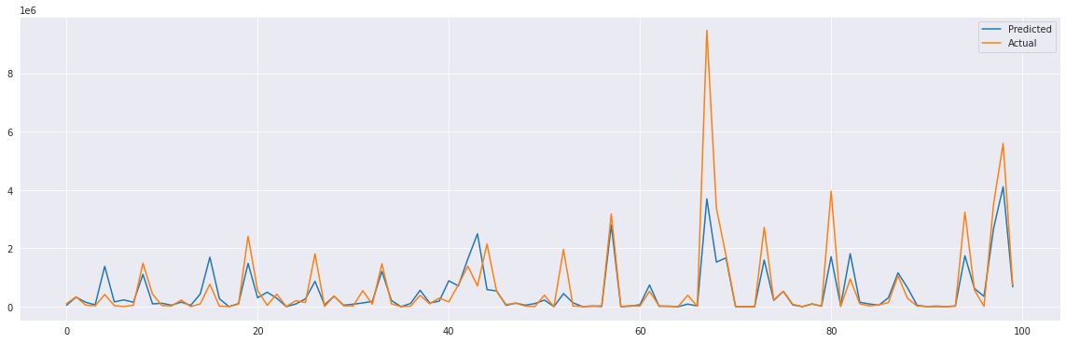
Simple Linear Model
**** Train Dataset Score ****
MSE is 122172.93932408596
RMSE is 349.53245818390883
R2 Score is 0.7057796681684716
Adj_R2 Score is 0.7041753673204879
**** Test Dataset Score ****
MSE is 118654.85597300377
RMSE is 344.46314167556994
R2 Score is 0.7164911542499833
Adj_R2 Score is 0.7102019912969766

Slide 22

Lasso Regression
**** Train Dataset Score ****
MSE is 122638.92968283774
RMSE is 350.198414734901
R2 Score is 0.7046574569919152
Adj_R2 Score is 0.7030470370415195
**** Test Dataset Score ****
MSE is 119117.34058079304
RMSE is 345.1338009827392
R2 Score is 0.7153861132783663
Adj_R2 Score is 0.7090724368653938

Slide 23

Ridge Regression
**** Train Dataset Score ****
MSE is 122446.64909732464
RMSE is 349.9237761246364
R2 Score is 0.7051205125424111
Adj_R2 Score is 0.7035126175038994
**** Test Dataset Score ****
MSE is 118958.71056172738
RMSE is 344.90391497013684
R2 Score is 0.7157651370716853
Adj_R2 Score is 0.7094598686587981

Slide 24
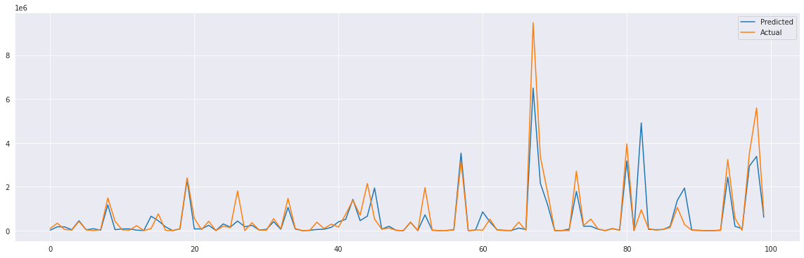
Decision Tree
**** Train Dataset Score ****
MSE is 56915.24781561856
RMSE is 238.56916778078966
R2 Score is 0.8629350886437778
Adj_R2 Score is 0.8621877121720406
**** Test Dataset Score ****
MSE is 93876.1713471477
RMSE is 306.39218551906265
R2 Score is 0.7756962851304123
Adj_R2 Score is 0.7707204876026573

Slide 25
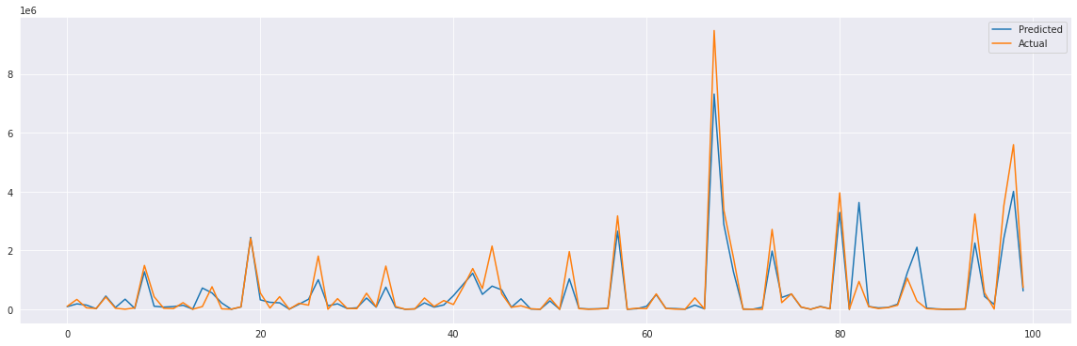
Random Forest
**** Train Dataset Score ****
MSE is 28232.991165299452
RMSE is 168.02675728972292
R2 Score is 0.9320085112529222
Adj_R2 Score is 0.9316377727578169
**** Test Dataset Score ****
MSE is 58335.34259485943
RMSE is 241.52710530054267
R2 Score is 0.8606160235931413
Adj_R2 Score is 0.8575240264515998

Slide 26
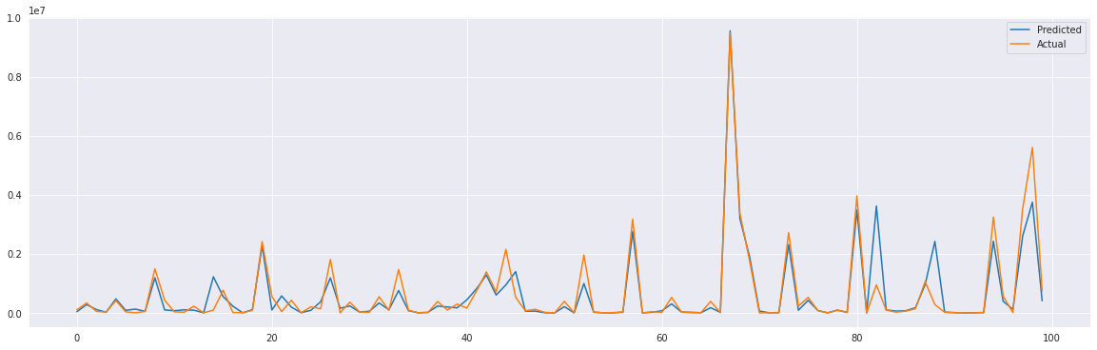
Gradient Boosting Regressor
**** Train Dataset Score ****
MSE is 1337.4286740695645
RMSE is 36.57087193477296
R2 Score is 0.9967791663975447
Adj_R2 Score is 0.996761604096369
**** Test Dataset Score ****
MSE is 59751.285582101234
RMSE is 244.44076088512986
R2 Score is 0.8572328298867489
Adj_R2 Score is 0.8540657823302378

Slide 27
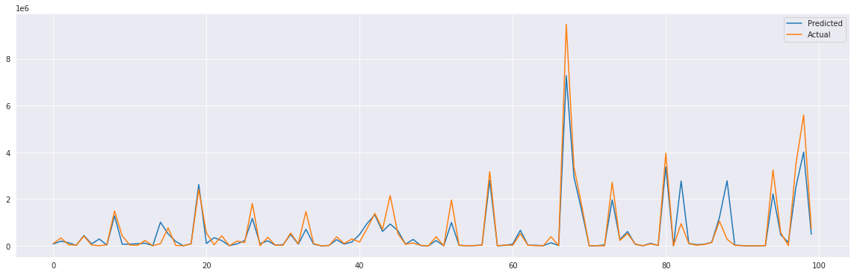
Bagging
**** Train Dataset Score ****
MSE is 7923.836680593607
RMSE is 89.015934981292
R2 Score is 0.9809175921407707
Adj_R2 Score is 0.9808135411293414
**** Test Dataset Score ****
MSE is 54773.44209954338
RMSE is 234.03726647596827
R2 Score is 0.8691266765270019
Adj_R2 Score is 0.8662234737879628

Slide 28
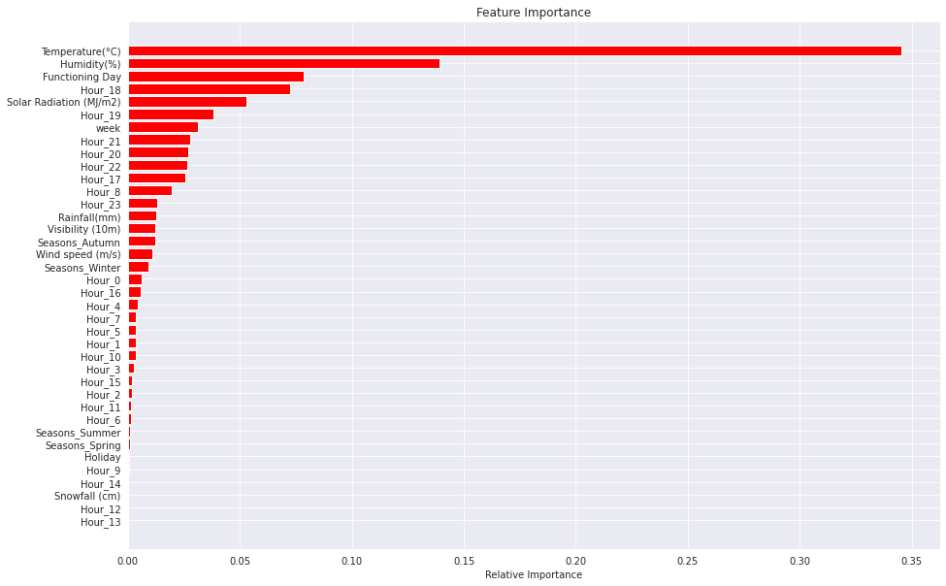
Feature Importance : Random Forest

Slide 29

Feature Importance : Gradient Boosting
Looking back at feature importance graph, temperature accounts for the highest importance

Slide 30
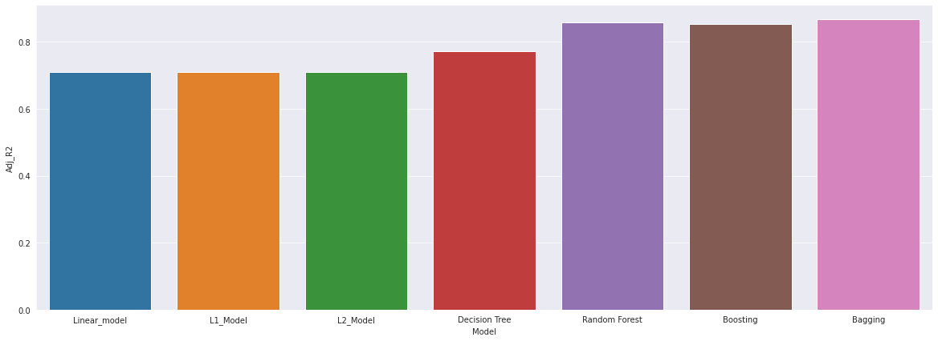
Score Board
Metrics | Linear model | L1_Model | L2_Model | Decision Tree | Random Forest | Boosting | Bagging
MSE | 118654.856 | 119117.3406 | 118958.7106 | 93876.17135 | 58335.34 | 59751.29 | 54773.44
RMSE | 344.4631417 | 345.133801 | 344.903915 | 306.3921855 | 241.5271 | 244.4408 | 234.0373
R2 | 0.716491154 | 0.715386113 | 0.715765137 | 0.775696285 | 0.860616 | 0.857233 | 0.869127
Adj_R2 | 0.710201991 | 0.709072437 | 0.709459869 | 0.770720488 | 0.857524 | 0.854066 | 0.866223

Slide 31
Conclusion
To what extent we can predict the bike count required for the stable supply of rental bikes using machine learning?
Multiple regressors were compared and evaluated with Adj_R2 and RMSE scores. With the best model, Bagging achieved an accuracy of 86% and RMSE of 234, which indicates that machine learning indeed can predict bike counts required for a stable supply of rental bikes
Which machine learning algorithm gives the highest prediction accuracy?
The Bagging regressor performed the best out of 7 traditional models on the data set. Which has produced the highest accuracy of Adj_R2 of 86%. The reason why this algorithm produced good results is because Bagging decreases variance, not bias, and solves over-fitting issues in a model.
Which features are the most important for bike count prediction?
The feature temperature accounts for the highest importance So, People of Seoul are more likely to stay home during colder days than on warmer ones. Depending on the feature importance of temperature and study on peoples activity associated with whether, temperature is the most important factor when it comes to sharing bikes.

Slide 32
Thank You

